Slide 1


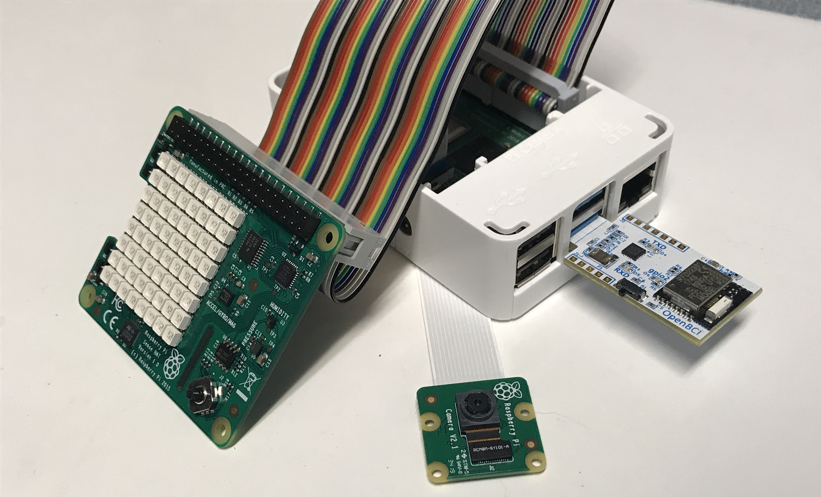
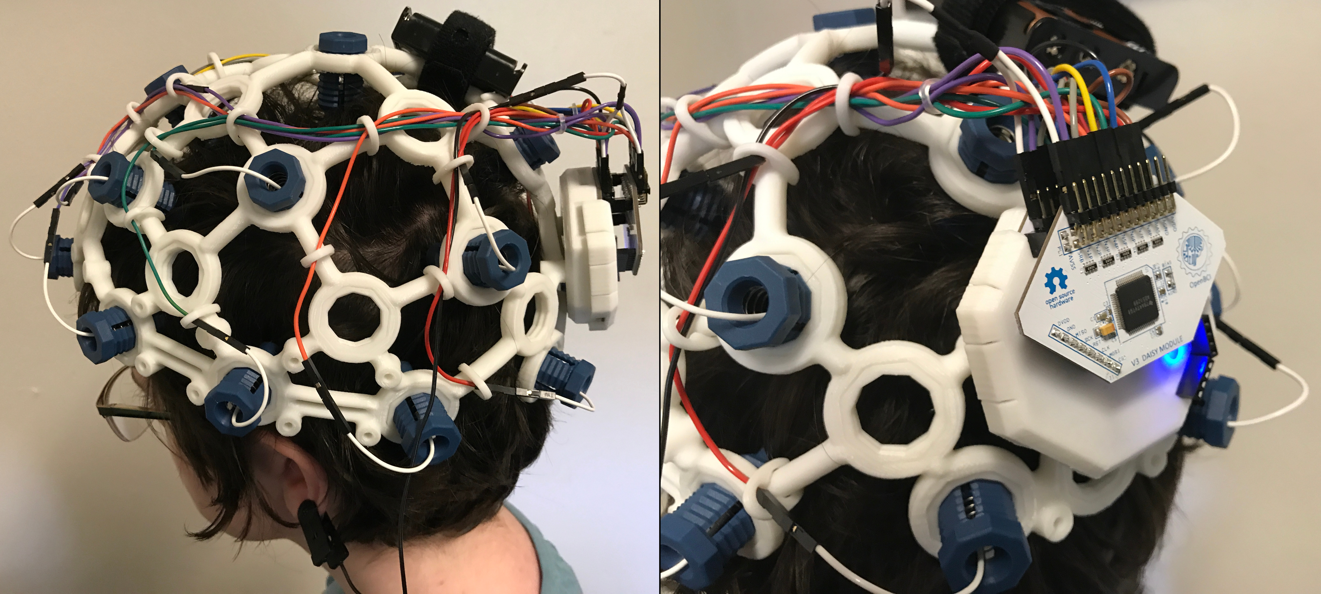
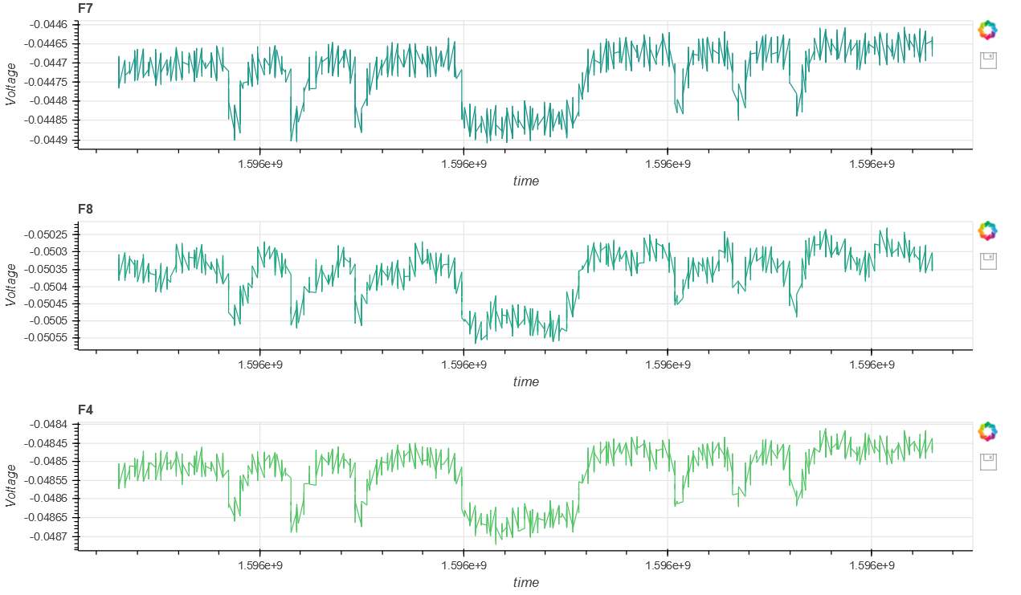
Algorithms for Complete Physiological Monitoring During Spaceflight
Aven Zitzelberger, Undergraduate, Computer Science and Engineering
Dr. Mohammad Ghassemi, Assistant Professor, Computer Science
Motivation
Next Steps
In the environment of a spacecraft, continuous passive monitoring of astronaut physiology is of critical importance. Current approaches to comprehensive health monitoring require a cumbersome array of various sensors which limit the mobility and comfort of astronauts and are collectively prone to malfunction. Together, these factors motivate the development of physiological monitoring algorithms that can accurately reconstruct a missing sensor’s data, using the values of the other measurements available.
Continuing this project, we will use publicly available bio-signal datasets to train a deep encoder-decoder network that can reconstruct the values of a missing waveform, using all other available waveforms. We expect to see robust correlations between physiological waveforms that will enable reconstruction of missing information and will allow us to identify potentially redundant health monitoring hardware for a spaceflight environment.
After this initial demonstration of efficacy, we will collect physiological and behavioral data of subjects performing multiple tasks in a laboratory environment. Following model development, we will test the ability of models trained on earth to be effectively tuned to new subjects and new tasks using transfer learning. This last point is of particularly importance as it will enable our methods to be tuned to individual astronauts after they’ve arrived on a spacecraft.
Previous Research
A great deal of research is being done on the topic of health monitoring, especially when it comes to methods that are invasive or time consuming. Much of this research focuses of on the extrapolation of bio-signals from different measurements. For example, PPG readings can be used to reconstruct ECG data¹. Similarly, ECG and PPT data can be used to predict blood pressure readings². Consequently, it is possible to extrapolate blood pressure from PPG and PPT data, and it has been done with up to 95% accuracy using machine learning models³. Clearly, This technology is extremely beneficial in monitoring bio-signals and diagnosing health risks, especially in the context of spaceflight⁴.
Fig. 1: Raspberry Pi sensor hub. From left to right: Sense Hat, Picam, and the OpenBCI dongle.
Objectives
Given the importance of physiological monitoring, the idiosyncratic nature of physiological waveforms, and the practical constraints of moving equipment into orbit, our objectives are to (1) develop algorithms that enable reliable, real-time reconstruction of missing physiological waveforms using one or more other available waveforms and to (2) discover the minimal subset of monitoring systems needed to obtain the best overall picture of physiological status.
Fig. 2: Wireless EEG setup.
References
[1] Q. Zhu, X. Tian, C.-W. Wong, and M. Wu, “ECG Reconstruction via PPG: A Pilot Study,” in 2019 IEEE EMBS International Conference on Biomedical Health Informatics (BHI), May 2019, pp. 1–4, doi: 10.1109/BHI.2019.8834612.
[2] O. Viunytskyi, V. Shulgin, V. Sharonov, and A. Totsky, “Non-invasive Cuff-less Measurement of Blood Pressure Based on Machine Learning,” in 2020 IEEE 15th International Conference on Advanced Trends in Radioelectronics, Telecommunications and Computer Engineering TCSET), Feb. 2020, pp. 203–206, doi: 10.1109/TCSET49122.2020.235423
[3] D. Jia and W. Yin, “Continuous blood pressure prediction based on hierarchical adaptive algorithm,” in 2020 IEEE 4th Information Technology, Networking, Electronic and Automation Control Conference (ITNEC), Jun. 2020, vol. 1, pp. 934–938, doi: 10.1109/ITNEC48623.2020.9084725.
[4] J. M. Eklund and N. Khan, “A bio-signal computing platform for real-time online health analytics for manned space missions,” in 2018 IEEE Aerospace Conference, Mar. 2018, pp. 1–8, doi: 10.1109/AERO.2018.8396819.
Methods
Data is collected from three sources, also shown in the figures to the right. The Pi Sense Hat streams temperature, humidity, pressure, and gyroscopic data, the Picam streams a live video feed, and the OpenBCI EEG headset stream EEG data to its corresponding dongle on the Raspberry Pi. These data streams are organized and packaged by the Pi, then streamed to our data-ingestion server for analysis. The data can then be viewed in a browser window after processing.
Fig. 3: Three EEG channels (F7, F8, and F4) viewed through a browser window. The decreases in voltages correspond to the subject’s eyes being closed.

